Slide 1

QISCOLLEGE OF ENGINEERING AND TECHNOLOGY : ONGOLE (AUTONOMOUS) Approved by AICTE | Permanent Affiliation: JNTU-Kakinada | UGC-Recognized Accredited by NBA | Accredited by NAAC | ISO 9001:2015 Certified Vengamukkapalem(V), Ongole, Prakasam dist., Andhra Pradesh-523272.
DEPARTMENT OF ELECTRONICS & COMMUNICATION ENGINEERING
DESIGN AND ANALYSIS OF FINITE IMPULSE RESPONSE USING GATE DIFFUSION INPUT (GDI) CIRCUITS
Submitted by
1. P. Prasanna(16491a04J5)
2. P. Nandini(16491a04J4)
3. T. Haritha(16491a04k1)
4. K.Pavaneswari17485a0401)
Under the guidance of
Mr. Ch. Arun Prakash
Assistant professor

Slide 2
Contents
Objective
overview
Literature review
Introduction
FIR filter
8-tap FIR design
GDI
Software used
Results
Future Scope
Conclusion
References

Slide 3
OBJECTIVE:
Design of 8-tap FIR design based on GDI cells has been implemented and compared with NMOS based circuits, and CMOS based circuits. The results show 8-tap FIR design using GDI has lower power consumption, higher performance, and less die area.

Slide 4
LITERATURE REVIEW:
the literature of the GDI technology, one realizes that there has been neither research nor project carried out on GDI implemented in DSP block. Moreover, in the previous technologies, several transistors were needed in order to design basic blocks. In the present project, however, basic blocks can be designed using as few as two transistors. The advantages of GDI– namely, high performance or high speed, low power consumption, and low area occupationlead the author of the present research to implement GDI in FIR filter.

Slide 5
INTRODUCTION :
FIR blocks are the most important blocks in design of Digital Signal Processing (DSP). They are widely used in industry and digital systems, such as: automotive, mobile phone, internet, laptop, computer, speech processing, Bluetooth headsets, and etc. The requirement to design an electronic system consists of two major components, the first one is Technology-driven and the second is Market-driven. Regarding technology driven, nowadays, most industries are improving their technology and devices considering greater complexity. It means more functionality, higher density in order to place millions of transistors on a lesser die area, increased performance and lower power dissipation

Slide 6
FIR FILTER :
Digital filters are typically used to modify or alter the attributes of a signal in the time or frequency domain. Digital signal processing (DSP) has become a mature technology and has replaced traditional analog signal processing systems in many applications. FIR filters are finite due to the fact that they have no feedback. Thus, if you send an impulse through the system (a single spike) then the output will unavoidably become zero as soon as the impulse runs through the filter. In such case, due to the lack of feedback in the FIR, the impulse response is finite. Lack of feedback guarantees the impulse response to be finite. Thus, the term "finite impulse response" may almost mean “lack of feedback”.

Slide 7
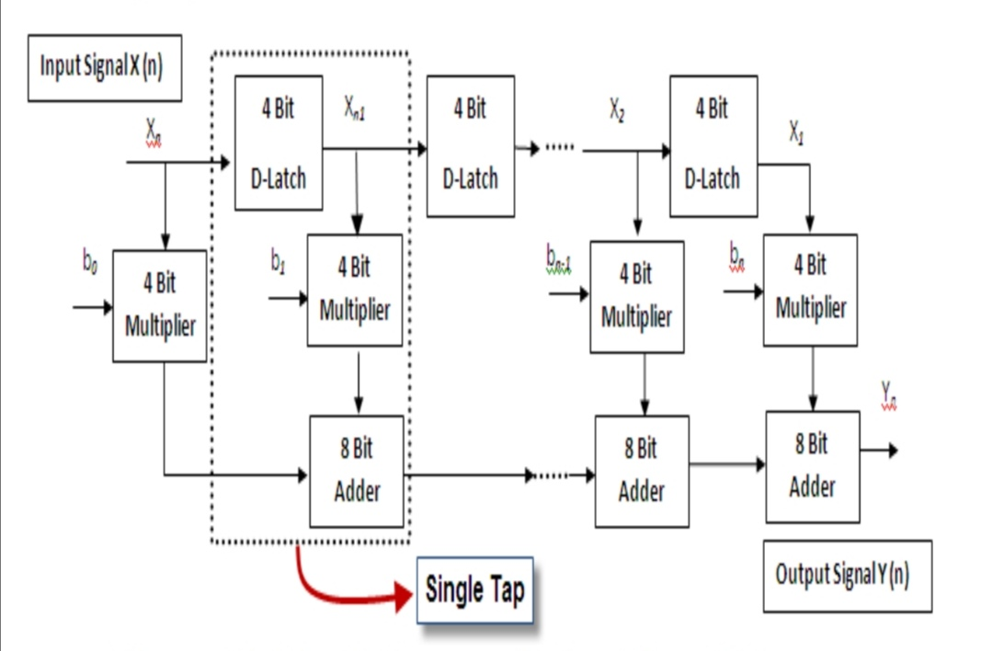
8-TAP FIR DESIGN:
The below Figure depicts the block of Direct form FIR (Finite Impulse Response) Filter and each tap includes D-Latch, Multiplier and Full Adder-Latch involve, 4-bit input and 4- bit output .the Multiplier contain two 4-bit input and 8-bit output. In this project 8 sequential tap have been used and the output of each D-Latch and Adder is the input the following tap.

Slide 8
GDI (Gate Diffusion Input) :
A new technique of low power digital circuit design is described. This technique allows reducing power consumption, delay and area of digital circuits, while maintaining low complexity of logic design. Performance comparison with traditional CMOS and various PTL design techniques is presented, with respect to the layout area, number of devices, delay and power dissipation, showing advantages and drawbacks of GDI as compared to other methods. A variety of logic gates have been implemented in 0.35 μm technology to compare the GDI technique with CMOS and PTL. A prototype test chip of 8-bit CLA adder has been fabricated, based on GDI and CMOS cell libraries, showing up to 45% reduction in power-delay product in GDI. Properties of implemented circuits are discussed, simulation results are reported and measurements of a test chip are presented.

Slide 9
SOFTWARE REQUIRED:
MICROWIND 3.1:
The MICROWIND software allows the designer to simulate and design an integrated circuit at physical description level. Born in Toulouse (France), Microwind is an innovative CMOS design tool for educational market.
Microwind unifies schematic entry, pattern based simulator, SPICE extraction of schematic, Verilog extractor, layout compilation, on layout mix-signal circuit simulation, cross sectional & 3D viewer, netlist extraction, BSIM4 tutorial on MOS devices and sign-off correlation to deliver unmatched design performance and productivity.

Slide 10
DSCH 3.5:
The DSCH program is a logic editor and simulator. DSCH is used to validate the architecture of the logic circuit before the microelectronics design is started. DSCH provides a user-friendly environment for hierarchical logic design, and fast simulation with delay analysis, which allows the design and validation of complex logic structures.
DSCH also features the symbols, models and assembly support for 8051 and PIC16F84 controllers.Designers can create logic circuits for interfacing with these controllers and verify software programs using DSCH.

Slide 11
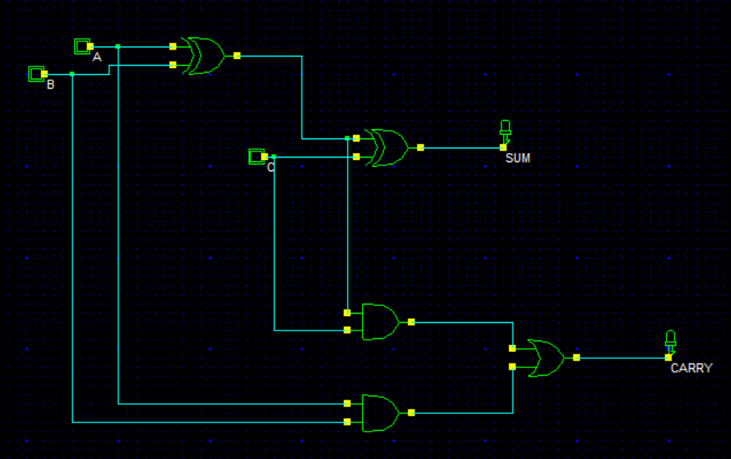
FULL ADDER SCHEMATIC

Slide 12
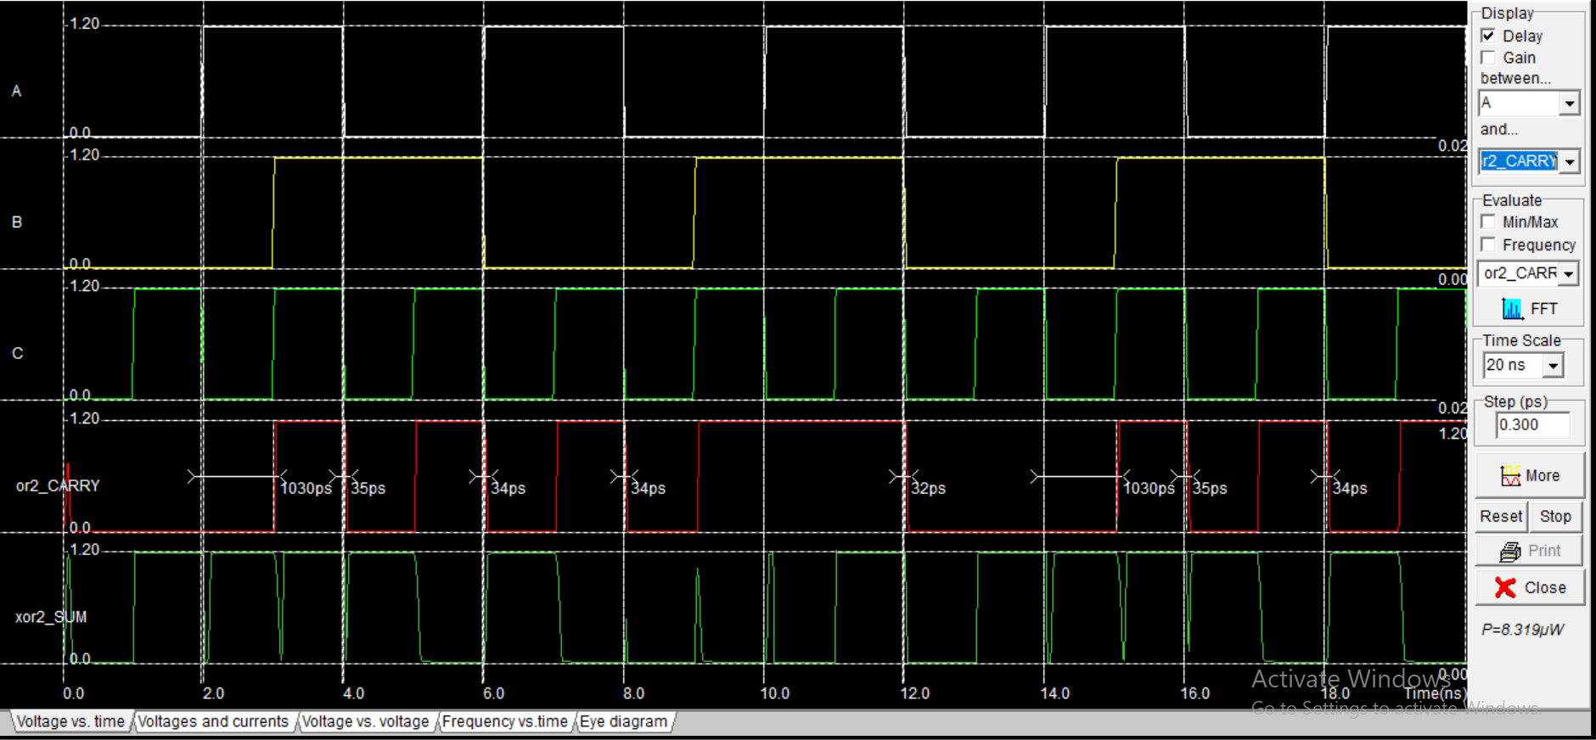
SIMULATION RESULTS OF FULL ADDER

Slide 13
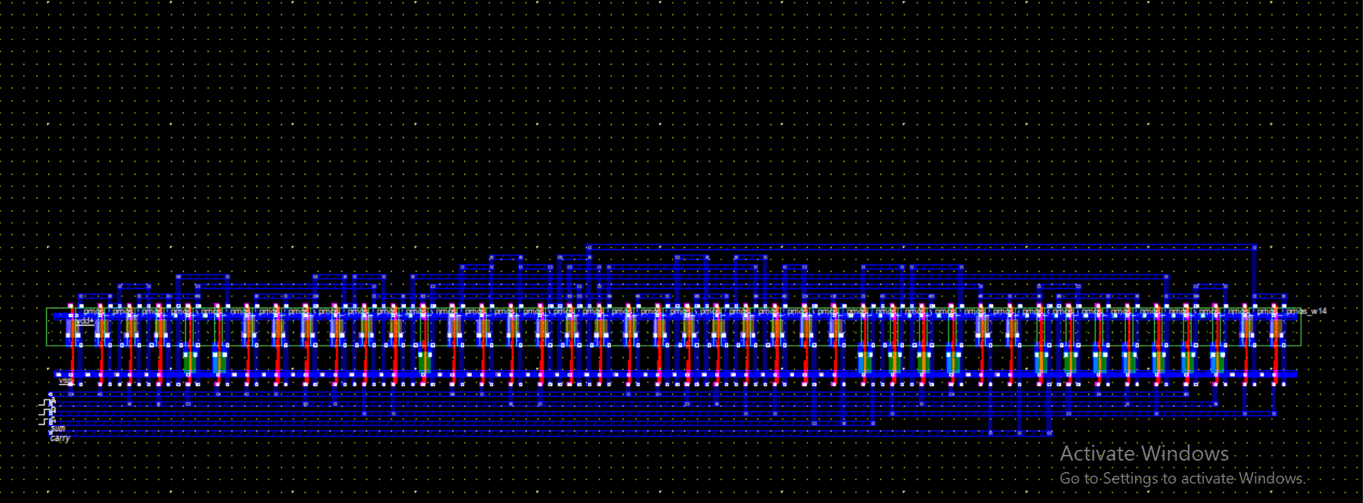
FULL ADDER USING CMOS TECHNOLOGY

Slide 14
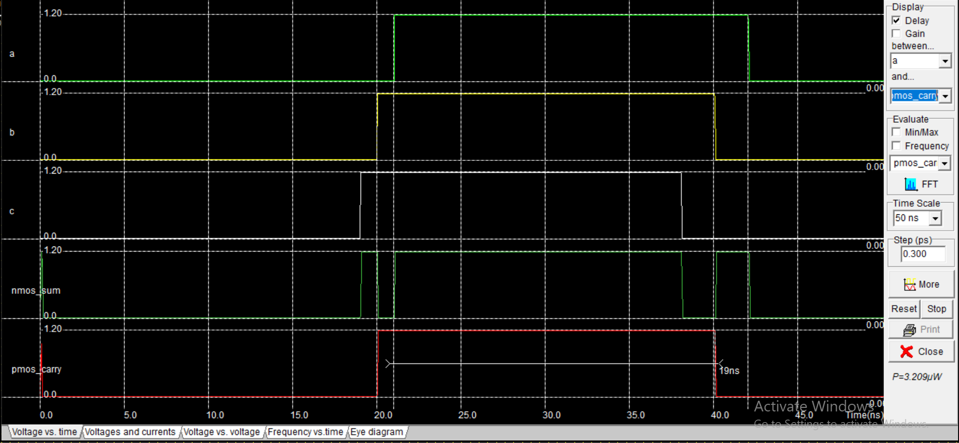
SIMULATION DIAGRAM OF FULL ADDER USING CMOS TECHNOLOGY

Slide 15
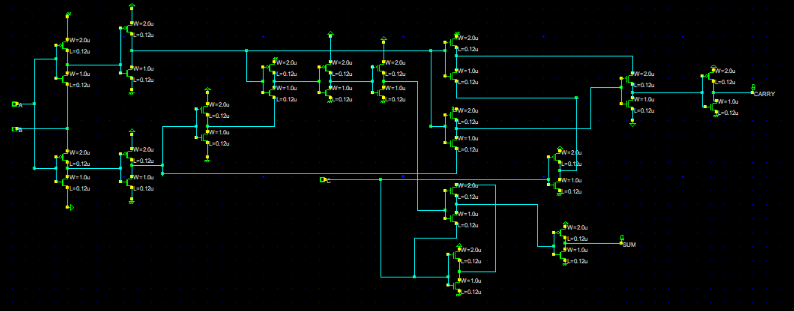
TRANSISTOR LEVEL SCHEMATIC OF THE GDI FAST FULL ADDER CELL

Slide 16
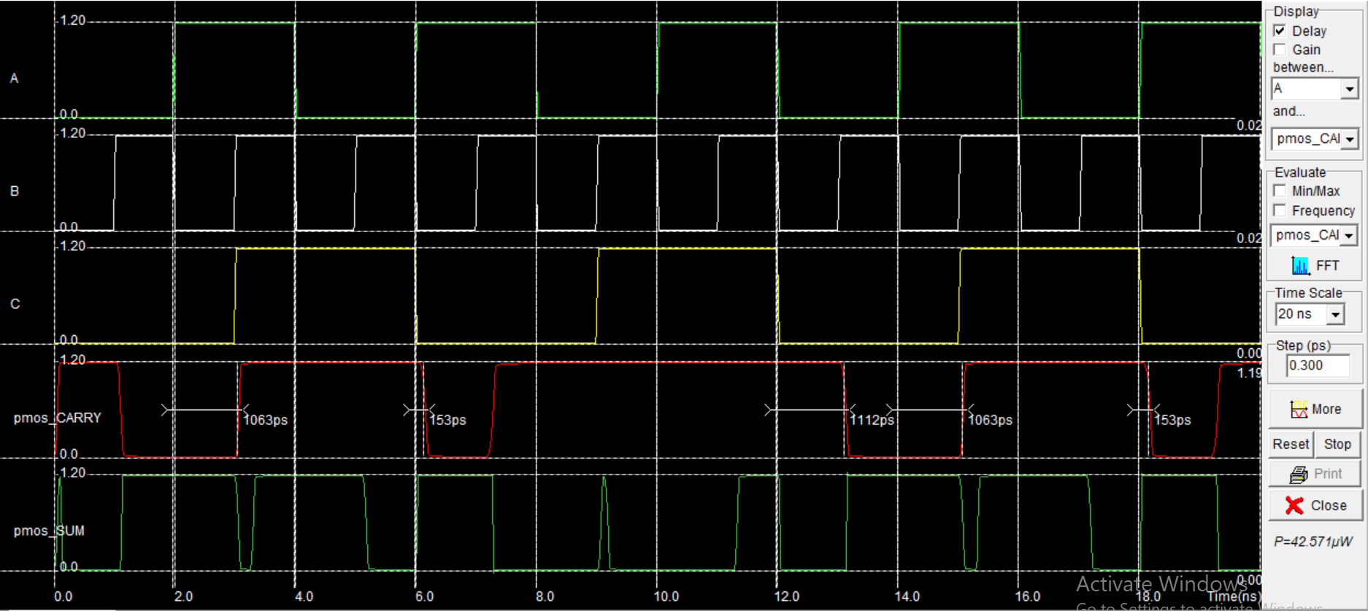
HSPICE SIMULATION RESULTS OF GDI FAST FULL ADDER CELL

Slide 17
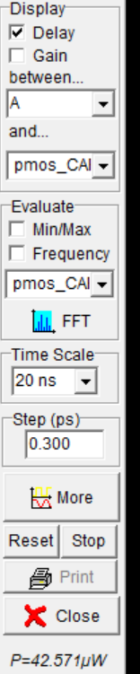
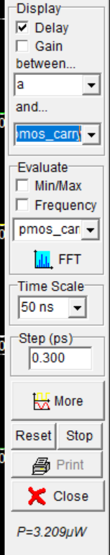
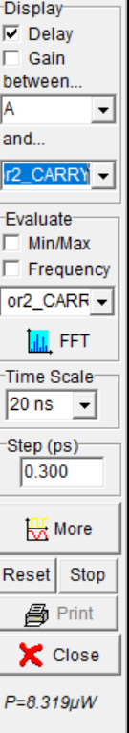
POWER DISSIPATION OF GDI FAST FULL ADDER CELL &FULL ADDER STRUCTURE AND COMS TECHNOLOGY:

Slide 18
FUTURE SCOPE
Adders are playing important roles for the operations like multiplication, filtering, counting, etc. They form foundations for most of the bigger system designs. This work also be implemented in future with other kinds of fast adder sub-systems like carry look-ahead adder, carry-skip adder, ripple carry adder, carry chain adders etc. ECAD tools like Digital Schematic(DSCH) and microwind editor are used to implement this study. Same study can be further extended to multiplier circuits like array multipliers and Wallace-tree multipliers. Multipliers can be designed using adders, this study helps to design multipliers with low power.

Slide 19
Conclusion :
In this research, 8-tap digital FIR filter has been designed and implemented. The basic cells such as adder, D-latch, and multiplier were implemented based on Gate Diffusion Input circuits. The simulation results shows that the layout area, propagation delay and power consumption were lower compared to NMOS and CMOS technology.

Slide 20
References:
N. Weste and K. Eshraghian, Principles of CMOS digital design. Reading, MA: Addison-Wesley, pp. 304–307.
2. J.M. Rabaey, A. Chandrakasan, B. Nikolic, “Digital Integrated Circuits”, 2nd edition, Prentice Hall, 2002,pp 491-621.

Slide 21
Guide Comments:

Slide 22
THANK YOU

